Slide 1
CS7015 (Deep Learning) : Lecture 12
Object Detection: R-CNN, Fast R-CNN, Faster R-CNN, You Only Look Once (YOLO)
Mitesh M. Khapra
Department of Computer Science and Engineering Indian Institute of Technology Madras

Slide 2
Acknowledgements
Some images borrowed from Ross Girshick’s original slides on RCNN, Fast RCNN, etc.
Some ideas borrowed from the presentation of Kaustav Kundu∗
∗ Deep Object Detection

Slide 3
Module 12.1 : Introduction to object detection

Slide 4
So far we have looked at Image Classification
We will now move on to another Image Processing Task - Object Detection

Slide 5
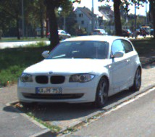
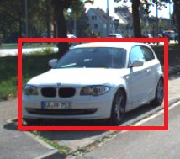
5/47

Slide 6
Task
Image classification
5/47

Slide 7
Task
Image classification
Output Car
5/47

Slide 8
Task
Image classification
Object Detection
Output Car
5/47

Slide 9
Task | Image classification | Object Detection
Output | Car | Car, exact bound- ing box contain- ing car
5/47

Slide 10
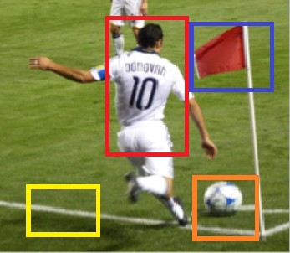
Let us see a typical pipeline for object detection
6/47

Slide 11
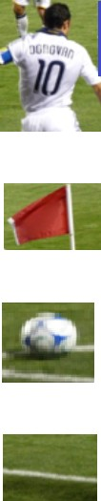
Region proposals
Let us see a typical pipeline for object detection
It starts with a region proposal stage where we identify potential regions which may contain objects
6/47

Slide 12
Region proposals
We could think of these regions as mini-images
6/47

Slide 13




Region proposals
Feature extraction
x₁ x₂
. . .
x_{d}
We could think of these regions as mini-images
We extract features(SIFT, HOG, CNNs) from these mini-images
6/47

Slide 14







Region proposals
Feature extraction
Classifier
person flag
ball
none
x₁ x₂
. . .
x_{d}
Pass these through a standard image classifer to determine the class
6/47

Slide 15
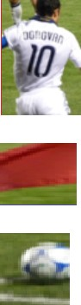
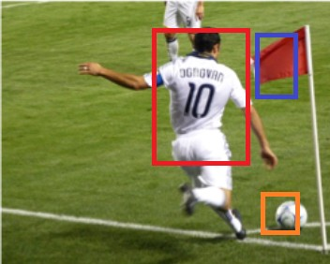
Region proposals
h
w
h
w
h
w
In addition we would also like to correct the proposed bounding boxes
7/47

Slide 16
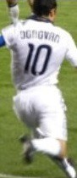


Region proposals
Bounding box regression
h
_{h}∗
_{w}∗
w
h
_{h}∗
_{w}∗
w
h
_{h}∗
_{w}∗
w
In addition we would also like to correct the proposed bounding boxes
This is posed as a regression problem (for example, we would like to predict w∗,
_{h}∗
from the proposed w and h)
Mitesh M. Khapra
7/47

Slide 17
Region proposals
Feature extraction
Bounding box regression
h
_{h}∗
x₁ x₂
. . .
x_{d}
_{w}∗
w
h
_{h}∗
_{w}∗
w
h
_{h}∗
_{w}∗
w
In addition we would also like to correct the proposed bounding boxes
This is posed as a regression problem (for example, we would like to predict w∗,
_{h}∗
from the proposed w and h)
Mitesh M. Khapra
7/47

Slide 18



Region proposals
Feature extraction
Classifier
Let us see how these three compo- nents have evolved over time
8/47

Slide 19
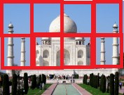
Region proposals
Feature extraction
Classifier
Let us see how these three compo- nents have evolved over time
Propose all possible regions in the image of varying sizes (almost brute force)
Pre 2012
8/47

Slide 20

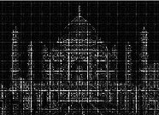
Region proposals
Feature extraction
Classifier
Let us see how these three compo- nents have evolved over time
Propose all possible regions in the image of varying sizes (almost brute force)
Use handcrafted features (SIFT, HOG)
Pre 2012
8/47

Slide 21
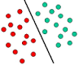
Region proposals
Feature extraction
Classifier
Let us see how these three compo- nents have evolved over time
Propose all possible regions in the image of varying sizes (almost brute force)
Use handcrafted features (SIFT, HOG)
Train a linear classifier using these features
Pre 2012
8/47

Slide 22
Region proposals
Feature extraction
Classifier
Let us see how these three compo- nents have evolved over time
Propose all possible regions in the image of varying sizes (almost brute force)
Use handcrafted features (SIFT, HOG)
Train a linear classifier using these features
We will now see three algorithms that progressively improve these compo- nents
Pre 2012
8/47

Slide 23
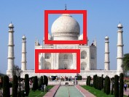
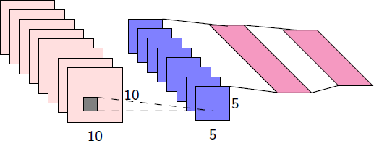
Region proposals
Feature extraction
Classifier
Let us see how these three compo- nents have evolved over time
Propose all possible regions in the image of varying sizes (almost brute force)
Use handcrafted features (SIFT, HOG)
Train a linear classifier using these features
We will now see three algorithms that progressively improve these compo- nents
Pre 2012
RCNN
8/47

Slide 24
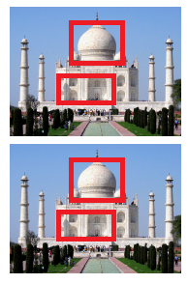
Region proposals
Feature extraction
Classifier
Let us see how these three compo- nents have evolved over time
Propose all possible regions in the image of varying sizes (almost brute force)
Use handcrafted features (SIFT, HOG)
Train a linear classifier using these features
We will now see three algorithms that progressively improve these compo- nents
Pre 2012
RCNN
Fast RCNN
8/47

Slide 25
Region proposals
Feature extraction
Classifier
Let us see how these three compo- nents have evolved over time
Propose all possible regions in the image of varying sizes (almost brute force)
Use handcrafted features (SIFT, HOG)
Train a linear classifier using these features
We will now see three algorithms that progressively improve these compo- nents
Pre 2012
RCNN
Fast RCNN
Faster RCNN
8/47

Slide 26
Module 12.2 : RCNN model for object detection

Slide 27
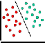
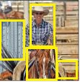

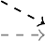


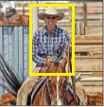
Classifier
.
Input
RegRioengiPonroPporosaplossals
Feature Extrac- tion
.
Bounding Box
10
10
5
5
Regression
10/47

Slide 28
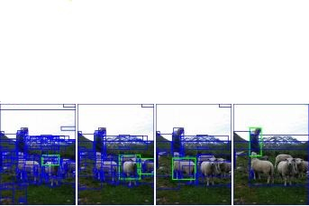
Classifier
.
Input
RegRioengiPonroPporosaplossals
Feature Extrac- tion
.
Bounding Box Regression
10
10
5
5
Selective Search for region proposals
10/47

Slide 29
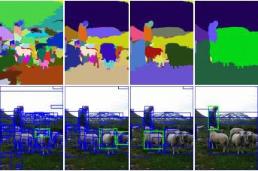
Classifier
.
Input
RegRioengiPonroPporosaplossals
Feature Extrac- tion
.
Bounding Box Regression
10
10
5
5
Selective Search for region proposals
Does hierarchical clustering at different scales
10/47

Slide 30
Classifier
.
Input
RegRioengiPonroPporosaplossals
Feature Extrac- tion
.
Bounding Box Regression
10
10
5
5
Selective Search for region proposals
Does hierarchical clustering at different scales
For example the figures from left to right show clusters of increasing sizes
10/47

Slide 31
Classifier
.
Input
RegRioengiPonroPporosaplossals
Feature Extrac- tion
.
Bounding Box Regression
10
10
5
5
Selective Search for region proposals
Does hierarchical clustering at different scales
For example the figures from left to right show clusters of increasing sizes
Such a hierarchical clustering is important as we may find different objects at different
scales
CS7015 (Deep Learning) : Lecture 12
10/47

Slide 32
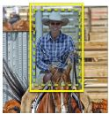
Classifier
.
Input
RegRioengiPonroPporosaplossals
Feature Extrac- tion
.
Bounding Box
10
10
5
5
Regression
11/47

Slide 33

Classifier
.
Input
RegRioengiPonroPporosaplossals
Feature Extrac- tion
.
Bounding Box Regression
10
10
5
5
Proposed regions are cropped to form mini im- ages
11/47

Slide 34
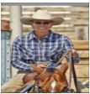
Classifier
.
Input
RegRioengiPonroPporosaplossals
Feature Extrac- tion
.
Bounding Box Regression
10
10
5
5
Proposed regions are cropped to form mini im- ages
Each mini image is scaled to match the CNN’s (feature extractor) input size
11/47

Slide 35
Classifier
.
Input
Region Proposals
Feature Extrac- tion
.
Bounding Box Regression
10
5
10 5
For feature extraction any CNN trained for Image Classification can be used (AlexNet/ VGGNet etc.)
12/47

Slide 36
Classifier
.
Input
Region Proposals
Feature Extrac- tion
.
Bounding Box Regression
10
5
10 5
For feature extraction any CNN trained for Image Classification can be used (AlexNet/ VGGNet etc.)
Outputs from fc7 layer are taken as features
12/47

Slide 37
Classifier
.
Input
Region Proposals
Feature Extrac- tion
.
Bounding Box Regression
10
5
10 5
For feature extraction any CNN trained for Image Classification can be used (AlexNet/ VGGNet etc.)
Outputs from fc7 layer are taken as features
CNN is fine tuned using ground truth (cropped) object images
fc7
10
10
5
5
12/47

Slide 38
Classifier
.
Input
Region Proposals
Feature Extrac- tion
.
Bounding Box Regression
10
10
5
5
13/47

Slide 39
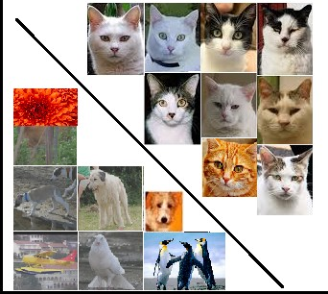
Classifier
.
Input
Region Proposals
Feature Extrac- tion
.
Bounding Box Regression
10
10
5
5
Linear models (SVMs) are used for classification
13/47

Slide 40
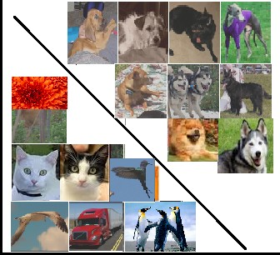
Classifier
.
Input
Region Proposals
Feature Extrac- tion
.
Bounding Box Regression
10
10
5
5
Linear models (SVMs) are used for classification (1 model per class)
13/47

Slide 41
Classifier
.
Input
Region Proposals
Feature Extrac- tion
.
Bounding Box Regression
10
10
5
5
. . .
Linear models (SVMs) are used for classification (1 model per class)
13/47

Slide 42
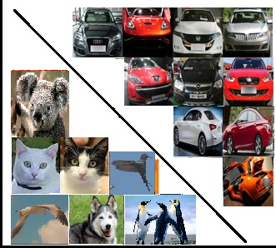
Classifier
.
Input
Region Proposals
Feature Extrac- tion
.
Bounding Box Regression
10
10
5
5
. . .
Linear models (SVMs) are used for classification (1 model per class)
13/47

Slide 43
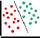
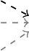
Classifier
.
Input
Region Proposals
Feature Extrac- tion
.
10
Bounding Box
5
Regression
10 5
14/47

Slide 44
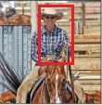
Classifier
.
Input
Region Proposals
Feature Extrac- tion
.
10
Bounding Box
10
5
5
Regression
^{h} (x,y)
w
Proposed Box
14/47

Slide 45
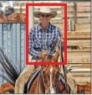
Classifier
.
Input
Region Proposals
Feature Extrac- tion
.
10
Bounding Box Regression
10
5
5
^{h} (x,y)
w
^{h∗}(x∗,y∗) _{w}∗
The proposed regions may not be perfect
Proposed Box
True Box
14/47

Slide 46
Classifier
.
Input
Region Proposals
Feature Extrac- tion
.
10
Bounding Box Regression
5
10 5
The proposed regions may not be perfect
We want to learn four regression models which will learn to predict x∗, y∗, w∗, h∗
^{h} (x,y)
w
^{h∗}(x∗,y∗) _{w}∗
Proposed Box
True Box
14/47

Slide 47
Classifier
.
Input
Region Proposals
Feature Extrac- tion
.
10
Bounding Box Regression
5
10 5
The proposed regions may not be perfect
We want to learn four regression models which will learn to predict x∗, y∗, w∗, h∗
We will see their respective objective functions
^{h} (x,y)
w
^{h∗}(x∗,y∗) _{w}∗
Proposed Box
True Box
14/47

Slide 48
Classifier
.
Input
Region Proposals
Feature Extrac- tion
.
10
Bounding Box Regression
10
5
5
N
∗
)₂
x − x
min
− w
T
1
z
w
i=1
^{h} (x,y)
w
^{h∗}(x∗,y∗) _{w}∗
Proposed Box True Box
z : features from pool5 layer of the network
14/47

Slide 49
Classifier
.
Input
Region Proposals
Feature Extrac- tion
.
10
Bounding Box Regression
5
10 5
N
∗
)₂
x − x
min
− w
T
1
z
w
i=1
h
(x,y)
w
h∗ ∗ ∗
^{x∗−x} is the normalized difference between proposed x
(x ,y )
w
and true x∗
_{w}∗
Proposed Box True Box
z : features from pool5 layer of the network
14/47

Slide 50
Classifier
.
Input
Region Proposals
Feature Extrac- tion
.
10
Bounding Box Regression
5
10 5
N
∗
)₂
x − x
min
− w
T
1
z
w
i=1
h
(x,y)
w
h∗ ∗ ∗
^{x∗−x} is the normalized difference between proposed x
(x ,y )
w
and true x∗
_{w}∗
If we can predict this difference we can compute x∗
Proposed Box True Box
z : features from pool5 layer of the network
14/47

Slide 51
Classifier
.
Input
Region Proposals
Feature Extrac- tion
.
10
Bounding Box Regression
5
10 5
N
∗
)₂
x − x
min
− w
T
1
z
w
i=1
h
(x,y)
w
h∗ ∗ ∗
^{x∗−x} is the normalized difference between proposed x
(x ,y )
w
and true x∗
_{w}∗
If we can predict this difference we can compute x∗
Proposed Box True Box
z : features from pool5 layer of the network
The model predicts w^{T} z as this difference
1
14/47

Slide 52
Classifier
.
Input
Region Proposals
Feature Extrac- tion
.
10
Bounding Box Regression
5
10 5
N
∗
)₂
x − x
min
− w
T
1
z
w
i=1
h
(x,y)
w
h∗ ∗ ∗
^{x∗−x} is the normalized difference between proposed x
(x ,y )
w
and true x∗
_{w}∗
If we can predict this difference we can compute x∗
Proposed Box True Box
z : features from pool5 layer of the network
The model predicts w^{T} z as this difference
1
The above objective function minimize the difference between the predicted and the actual value
14/47

Slide 53
Classifier
.
Input
Region Proposals
Feature Extrac- tion
.
10
Bounding Box Regression
10
5
5
N
∗
)₂
y − y
min
− w
T
2
z
h
i=1
^{h} (x,y)
w
^{h∗}(x∗,y∗) _{w}∗
Similarly for y
Proposed Box True Box
z : features from pool5 layer of the network
14/47

Slide 54
Classifier
.
Input
Region Proposals
Feature Extrac- tion
.
10
Bounding Box
10
5
5
Regression
N
)
)₂
w
∗
min
ln
T
− w z
w
3
i=1
^{h} (x,y)
w
^{h∗}(x∗,y∗) _{w}∗
Similarly for w
Proposed Box True Box
z : features from pool5 layer of the network
14/47

Slide 55
Classifier
.
Input
Region Proposals
Feature Extrac- tion
.
10
Bounding Box
10
5
5
Regression
N
)
)₂
h
∗
min
ln
T
− w z
h
4
i=1
^{h} (x,y)
w
^{h∗}(x∗,y∗) _{w}∗
Similarly for h
Proposed Box True Box
z : features from pool5 layer of the network
14/47

Slide 56
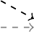

Classifier
.
Input
RegRioengiPonroPporosaplossals
Feature Extrac- tion
.
Bounding Box Regression
10
5
10 5
What are the parameters of this model?
15/47

Slide 57
Classifier
WCONV
Wclassifier
.
Input
RegRioengiPonroPporosaplossals
Feature Extrac- tion
.
Bounding Box Regression
10
5
5
10
Wregression
What are the parameters of this model?
15/47

Slide 58
Classifier
WCONV
Wclassifier
.
Input
RegRioengiPonroPporosaplossals
Feature Extrac- tion
.
Bounding Box Regression
10
5
10 5
Wregression
What are the parameters of this model?
W_{CONV} is taken as it is from a CNN trained for Image classification (say on ImageNet)
15/47

Slide 59
Classifier
WCONV
Wclassifier
.
Input
RegRioengiPonroPporosaplossals
Feature Extrac- tion
.
Bounding Box Regression
10
5
10 5
Wregression
What are the parameters of this model?
W_{CONV} is taken as it is from a CNN trained for Image classification (say on ImageNet)
W_{CONV} is then fine tuned using ground truth (cropped) object images
15/47

Slide 60
Classifier
WCONV
Wclassifier
.
Input
RegRioengiPonroPporosaplossals
Feature Extrac- tion
.
Bounding Box Regression
10
5
10 5
Wregression
What are the parameters of this model?
W_{CONV} is taken as it is from a CNN trained for Image classification (say on ImageNet)
W_{CONV} is then fine tuned using ground truth (cropped) object images
W_{classifier} is learned using ground truth (cropped) object images
15/47

Slide 61
Classifier
WCONV
Wclassifier
.
Input
RegRioengiPonroPporosaplossals
Feature Extrac- tion
.
Bounding Box Regression
10
5
10 5
Wregression
What are the parameters of this model?
W_{CONV} is taken as it is from a CNN trained for Image classification (say on ImageNet)
W_{CONV} is then fine tuned using ground truth (cropped) object images W_{classifier} is learned using ground truth (cropped) object images W_{regression} is learned using ground truth bounding boxes
15/47

Slide 62
Classifier
.
Input
RegRioengiPonroPporosaplossals
Feature Extrac- tion
.
Bounding Box Regression
10
5
10 5
What is the computational cost for processing one image at test time?
16/47

Slide 63
Classifier
.
Input
RegRioengiPonroPporosaplossals
Feature Extrac- tion
.
Bounding Box Regression
10
5
10 5
What is the computational cost for processing one image at test time?
Inference Time = Proposal Time + # Proposals × Convolution Time + # Proposals × classification + # Proposals × regression
16/47

Slide 64
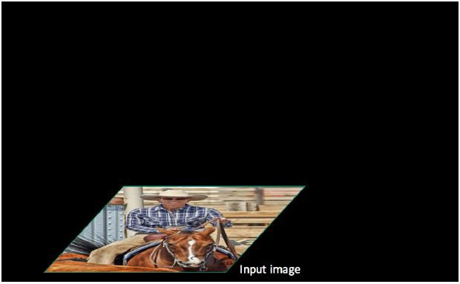
Source: Ross Girshick
17/47

Slide 65
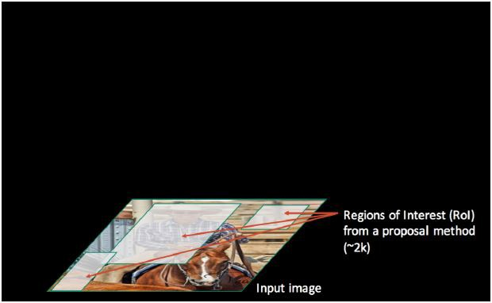
On average selective search gives 2K region proposal
Source: Ross Girshick
17/47

Slide 66
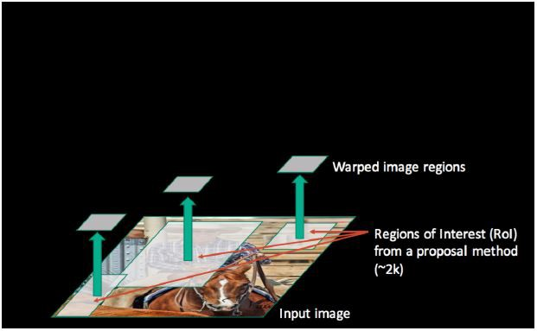
On average selective search gives 2K region proposal
Source: Ross Girshick
17/47

Slide 67
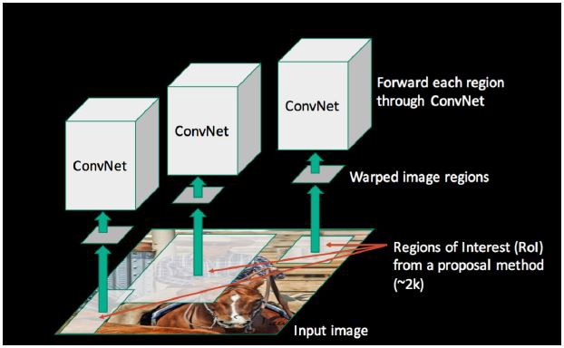
On average selective search gives 2K region proposal
Each of these pass through the CNN for feature extrac- tion
Source: Ross Girshick
17/47

Slide 68
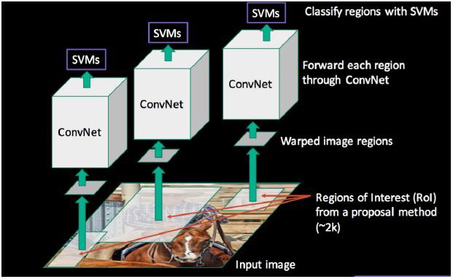
On average selective search gives 2K region proposal
Each of these pass through the CNN for feature extrac- tion
Followed by classification and regression
Source: Ross Girshick
17/47

Slide 69
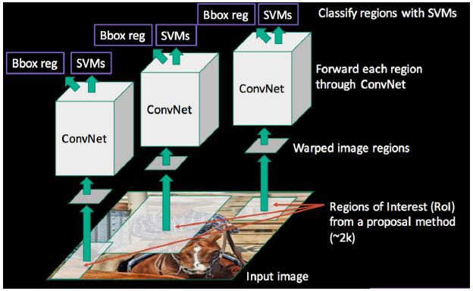
On average selective search gives 2K region proposal
Each of these pass through the CNN for feature extrac- tion
Followed by classification and regression
Source: Ross Girshick
17/47

Slide 70
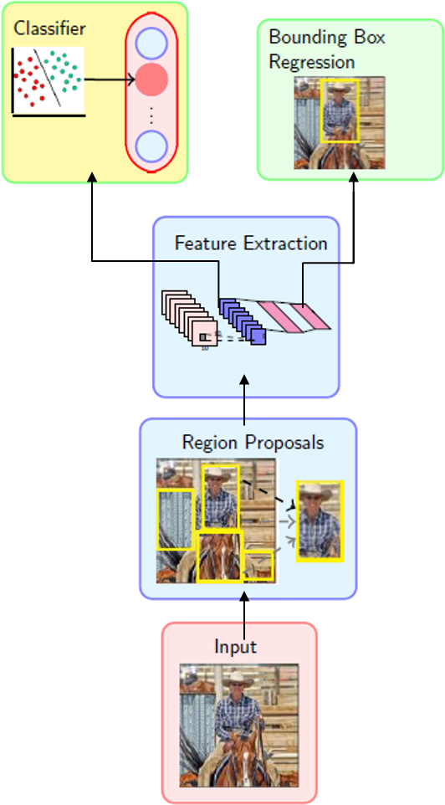
No joint learning
¹Source: Ross Girshick
¹Using VGG-Net
18/47

Slide 71
No joint learning
Use ad hoc training objectives
¹Source: Ross Girshick
¹Using VGG-Net
18/47

Slide 72
No joint learning
Use ad hoc training objectives
Fine tune network with softmax classifier (log loss)
¹Source: Ross Girshick
¹Using VGG-Net
18/47

Slide 73
No joint learning
Use ad hoc training objectives
Fine tune network with softmax classifier (log loss)
Train post-hoc linear SVMs (hinge loss)
¹Source: Ross Girshick
¹Using VGG-Net
18/47

Slide 74
No joint learning
Use ad hoc training objectives
Fine tune network with softmax classifier (log loss)
Train post-hoc linear SVMs (hinge loss)
Train post-hoc bounding-box re-
gressors (squared loss)
¹Source: Ross Girshick
¹Using VGG-Net
18/47

Slide 75
No joint learning
Use ad hoc training objectives
Fine tune network with softmax classifier (log loss)
Train post-hoc linear SVMs (hinge loss)
Train post-hoc bounding-box re-
gressors (squared loss)
Training (≈ 3 days) and testing (47s per image) is slow¹.
¹Source: Ross Girshick
¹Using VGG-Net
18/47

Slide 76
No joint learning
Use ad hoc training objectives
Fine tune network with softmax classifier (log loss)
Train post-hoc linear SVMs (hinge loss)
Train post-hoc bounding-box re-
gressors (squared loss)
Training (≈ 3 days) and testing (47s per image) is slow¹.
Takes a lot of disk space
¹Source: Ross Girshick
¹Using VGG-Net
18/47

Slide 77
Region proposals
Feature extraction
Classifier
Region Proposals: Selective Search
Pre 2012
RCNN
19/47

Slide 78
Region proposals
Feature extraction
Classifier
Region Proposals: Selective Search
Feature Extraction: CNNs
Pre 2012
RCNN
19/47

Slide 79
Region proposals
Feature extraction
Classifier
Region Proposals: Selective Search
Feature Extraction: CNNs
Classifier: Linear
Pre 2012
RCNN
19/47

Slide 80
Module 12.3 : Fast RCNN model for object detection

Slide 81
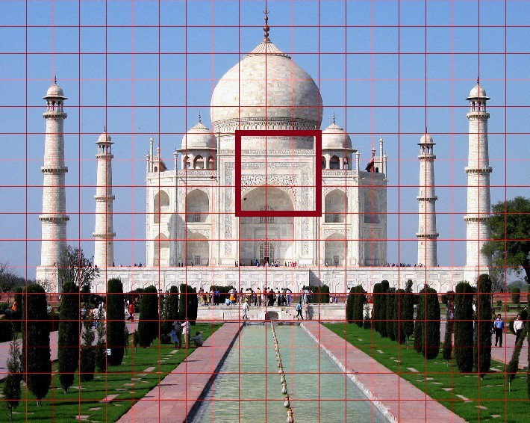
Suppose we apply a 3 × 3 kernel on an image
21/47

Slide 82
Suppose we apply a 3 × 3 kernel on an image
What is the region of influence of each pixel in the resulting output ?
21/47

Slide 83
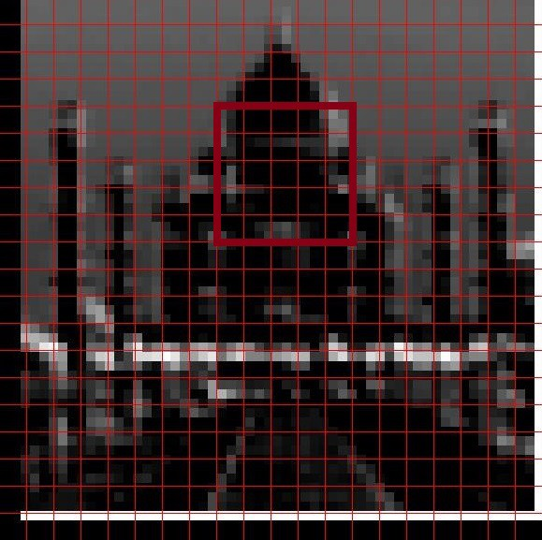
Suppose we apply a 3 × 3 kernel on an image
What is the region of influence of each pixel in the resulting output ?
Each pixel contributes to a 5 × 5 re- gion
21/47

Slide 84
Suppose we apply a 3 × 3 kernel on an image
What is the region of influence of each pixel in the resulting output ?
Each pixel contributes to a 5 × 5 re- gion
Suppose we again apply a 3 × 3 kernel on this output?
21/47

Slide 85
Suppose we apply a 3 × 3 kernel on an image
What is the region of influence of each pixel in the resulting output ?
Each pixel contributes to a 5 × 5 re- gion
Suppose we again apply a 3 × 3 kernel on this output?
What is the region of influence of the original pixel from the input ?
21/47

Slide 86
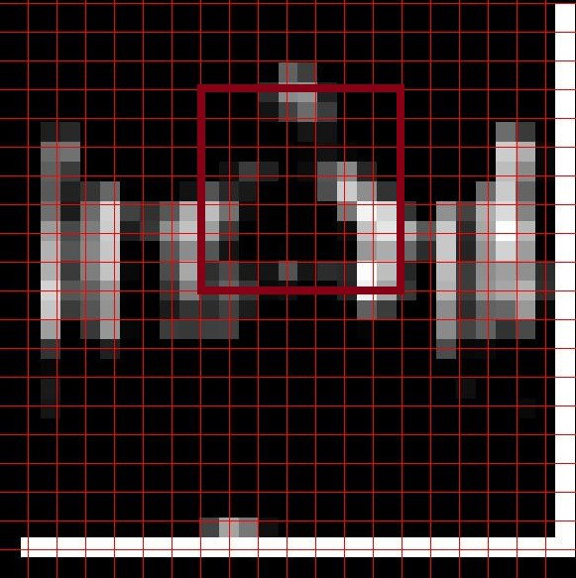
Suppose we apply a 3 × 3 kernel on an image
What is the region of influence of each pixel in the resulting output ?
Each pixel contributes to a 5 × 5 re- gion
Suppose we again apply a 3 × 3 kernel on this output?
What is the region of influence of the original pixel from the input ?
21/47

Slide 87
Suppose we apply a 3 × 3 kernel on an image
What is the region of influence of each pixel in the resulting output ?
Each pixel contributes to a 5 × 5 re- gion
Suppose we again apply a 3 × 3 kernel on this output?
What is the region of influence of the original pixel from the input ? (a 7×7 region)
21/47

Slide 88



softmax
224
64
224
112
112
56
56
28
28
14
64 128
maxpool Conv
128
512
14
7
112
112
56
56
28
28
14
14
512
7
224
224
512
256
512
maxpool
maxpool
256
maxpool
Conv
maxpool
Conv
Conv
Input
Conv
fc fc
1000
4096 4096

Slide 89
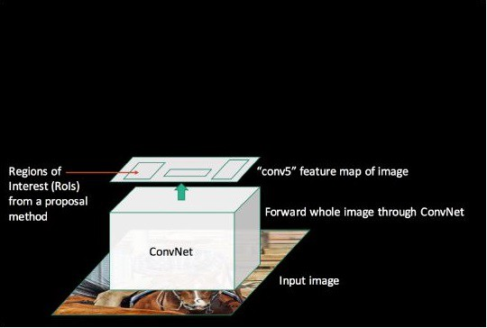
Using this idea we could get a bound- ing box’s region of influence on any layer in the CNN
Source: Ross Girshick
23/47

Slide 90
Using this idea we could get a bound- ing box’s region of influence on any layer in the CNN
The projected Region of Interest (RoI) may be of different sizes
Source: Ross Girshick
23/47

Slide 91
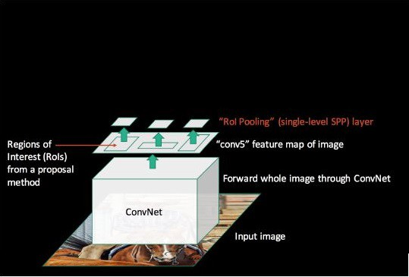
Using this idea we could get a bound- ing box’s region of influence on any layer in the CNN
The projected Region of Interest (RoI) may be of different sizes
Divide them into k equally sized re- gions of dimension H × W and do max pooling in each of those regions to construct a k dimensional vector
Source: Ross Girshick
23/47

Slide 92
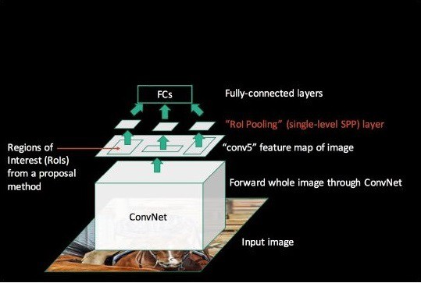
Using this idea we could get a bound- ing box’s region of influence on any layer in the CNN
The projected Region of Interest (RoI) may be of different sizes
Divide them into k equally sized re- gions of dimension H × W and do
max pooling in each of those regions to construct a k dimensional vector
Connect the k dimensional vector to a fully connected layer
Source: Ross Girshick
23/47

Slide 93
Using this idea we could get a bound- ing box’s region of influence on any layer in the CNN
The projected Region of Interest (RoI) may be of different sizes
Divide them into k equally sized re- gions of dimension H × W and do
max pooling in each of those regions to construct a k dimensional vector
Connect the k dimensional vector to a fully connected layer
This max pooling operation is call RoI pooling
Source: Ross Girshick
23/47

Slide 94
Once we have the FC layer it gives us the representation of this region pro- posal
Source: Ross Girshick
24/47

Slide 95
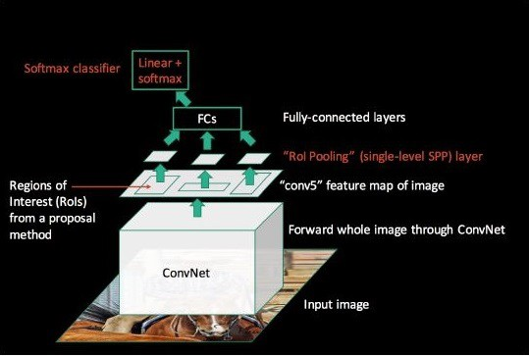
Once we have the FC layer it gives us the representation of this region pro- posal
We can then add a softmax layer on top of it to compute a probability distribution over the possible object classes
Source: Ross Girshick
24/47

Slide 96
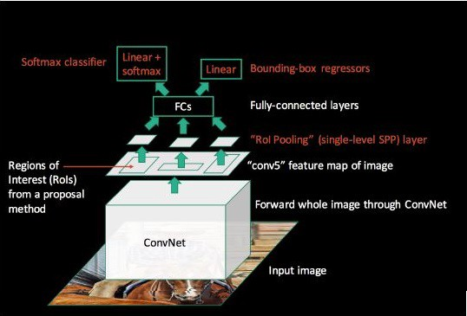
Once we have the FC layer it gives us the representation of this region pro- posal
We can then add a softmax layer on top of it to compute a probability distribution over the possible object classes
Similarly we can add a regression layer on top of it to predict the new bounding box (w∗, h∗, x∗, y∗)
Source: Ross Girshick
24/47

Slide 97
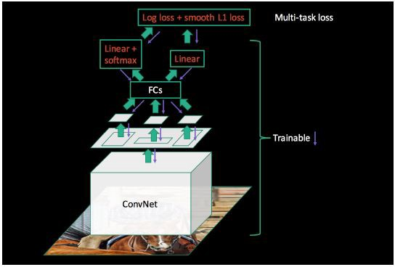
Once we have the FC layer it gives us the representation of this region pro- posal
We can then add a softmax layer on top of it to compute a probability distribution over the possible object classes
Similarly we can add a regression layer on top of it to predict the new bounding box (w∗, h∗, x∗, y∗)
Source: Ross Girshick
24/47

Slide 98

Recall that the last pooling layer of VGGNet-16 results in an output of size 512 × 7 × 7
Max-pool
Conv
Input
25/47

Slide 99
Recall that the last pooling layer of VGGNet-16 results in an output of size 512 × 7 × 7
ROI
We replace the last max pooling layer by a RoI pooling layer
Max-pool
Conv
Input
25/47

Slide 100
Recall that the last pooling layer of VGGNet-16 results in an output of size 512 × 7 × 7
ROI
We replace the last max pooling layer by a RoI pooling layer
We set H = W = 7 and divide each of these RoIs into (k = 49) regions
Max-pool
Conv
Input
25/47

Slide 101
Recall that the last pooling layer of VGGNet-16 results in an output of size 512 × 7 × 7
ROI
We replace the last max pooling layer by a RoI pooling layer
We set H = W = 7 and divide each of these RoIs into (k = 49) regions
We do this for every feature map re- sulting in an ouput of size 512 × 49
Max-pool
Conv
Input
25/47

Slide 102
Recall that the last pooling layer of VGGNet-16 results in an output of size 512 × 7 × 7
ROI
We replace the last max pooling layer by a RoI pooling layer
We set H = W = 7 and divide each of these RoIs into (k = 49) regions
We do this for every feature map re- sulting in an ouput of size 512 × 49
This output is of the same size as the output of the original max pooling layer
Max-pool
Conv
Input
25/47

Slide 103
It is thus compatible with the dimen- sions of the weight matrix connecting the original pooling layer to the first FC layer
W
ROI
Max-pool
Conv
Input
25/47

Slide 104
It is thus compatible with the dimen- sions of the weight matrix connecting the original pooling layer to the first FC layer
W
ROI
We can just retain that weight matrix and fine tune it
Max-pool
Conv
Input
25/47

Slide 105
Region proposals
Feature extraction
Classifier
Region
Search
Proposals:
Selective
Pre 2012
RCNN
Fast RCNN
26/47

Slide 106
Region proposals
Feature extraction
Classifier
Region Proposals: Selective Search
Feature Extraction: CNN
Pre 2012
RCNN
Fast RCNN
26/47

Slide 107
Region proposals
Feature extraction
Classifier
Region Proposals: Selective Search
Feature Extraction: CNN
Classifier: CNN
Pre 2012
RCNN
Fast RCNN
26/47

Slide 108
Module 12.4 : Faster RCNN model for object detection

Slide 109
So far the region proposals were be- ing made using Selective Search algo- rithm
28/47

Slide 110
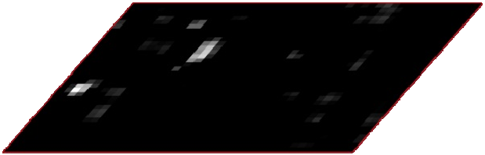


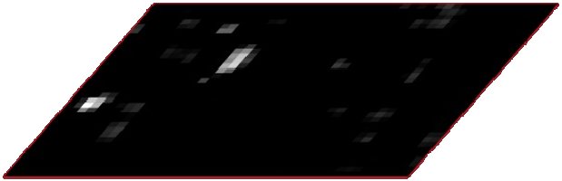
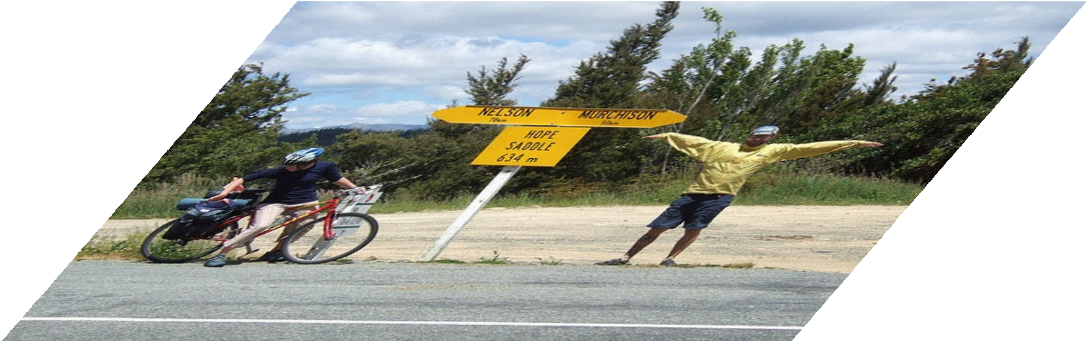
So far the region proposals were be- ing made using Selective Search algo- rithm
classifier
RoI pooling
Idea: Can we use a CNN for making region proposals also?
proposals
Region Proposal Network
feature maps
conv layers
image
28/47

Slide 111
So far the region proposals were be- ing made using Selective Search algo- rithm
classifier
RoI pooling
Idea: Can we use a CNN for making region proposals also?
How? Well it’s slightly tricky
proposals
Region Proposal Network
feature maps
conv layers
image
28/47

Slide 112
So far the region proposals were be- ing made using Selective Search algo- rithm
classifier
RoI pooling
Idea: Can we use a CNN for making region proposals also?
How? Well it’s slightly tricky
We will illustrate this using VG- GNet
proposals
Region Proposal Network
feature maps
conv layers
image
28/47

Slide 113
Consider the output of the last con- volutional layer of VGGNet
h
512
w
29/47

Slide 114
Consider the output of the last con- volutional layer of VGGNet
Now consider one cell in one of the 512 feature maps
h
512
w
29/47

Slide 115
Consider the output of the last con- volutional layer of VGGNet
Now consider one cell in one of the 512 feature maps
h
512
w
If we apply a 3 × 3 kernel around this
cell then we will get a 1D representa- tion for this cell
29/47

Slide 116
Consider the output of the last con- volutional layer of VGGNet
Now consider one cell in one of the 512 feature maps
h
512
w
If we apply a 3 × 3 kernel around this
cell then we will get a 1D representa- tion for this cell
29/47

Slide 117
Consider the output of the last con- volutional layer of VGGNet
Now consider one cell in one of the 512 feature maps
h
512
w
If we apply a 3 × 3 kernel around this
cell then we will get a 1D representa- tion for this cell
If we repeat this for all the 512 feature maps then we will get a 512 dimen- sional representation for this position
x₁ | x₂ |  |  |  |  |  |  |  | x5·12
29/47

Slide 118
Consider the output of the last con- volutional layer of VGGNet
Now consider one cell in one of the 512 feature maps
h
512
w
If we apply a 3 × 3 kernel around this
cell then we will get a 1D representa- tion for this cell
If we repeat this for all the 512 feature maps then we will get a 512 dimen- sional representation for this position
We use this process to get a 512 di- mensional representation for each of the w × h positions
x₁ | x₂ |  |  |  |  |  |  |  | x5·12
x₁ | x₂ |  |  |  |  |  |  |  | x5·12
29/47

Slide 119
Consider the output of the last con- volutional layer of VGGNet
Now consider one cell in one of the 512 feature maps
h
512
w
If we apply a 3 × 3 kernel around this
cell then we will get a 1D representa- tion for this cell
If we repeat this for all the 512 feature maps then we will get a 512 dimen- sional representation for this position
We use this process to get a 512 di- mensional representation for each of the w × h positions
x₁ | x₂ |  |  |  |  |  |  |  | x5·12
x₁ | x₂ |  |  |  |  |  |  |  | x5·12
x₁ | x₂ |  |  |  |  |  |  |  | x5·12
29/47

Slide 120

x₁ | x₂ | · | · | · | · | x | 512
Max-pool
Conv
Input
30/47

Slide 121

x₁
x₂
·
·
·
·
x
512
We now consider k bounding boxes (called anchor boxes) of different sizes & aspect ratio
Max-pool
Conv
Input
30/47

Slide 122
x₁
x₂
·
·
·
·
x
512
We now consider k bounding boxes (called anchor boxes) of different sizes & aspect ratio
We are interested in the following two questions:
Max-pool
Conv
Input
30/47

Slide 123
x₁
x₂
·
·
·
·
x
512
We now consider k bounding boxes (called anchor boxes) of different sizes & aspect ratio
We are interested in the following two questions:
Given the 512d representation of a position, what is the probability that a given anchor box centered at this position contains an object?
Max-pool
Conv
Input
30/47

Slide 124
x₁
x₂
·
·
·
·
x
512
We now consider k bounding boxes (called anchor boxes) of different sizes & aspect ratio
We are interested in the following two questions:
Given the 512d representation of a position, what is the probability that a given anchor box centered at this position contains an object? (Classification)
Max-pool
Conv
Input
30/47

Slide 125
x₁
x₂
·
·
·
·
x
512
We now consider k bounding boxes (called anchor boxes) of different sizes & aspect ratio
We are interested in the following two questions:
Given the 512d representation of a position, what is the probability that a given anchor box centered at this position contains an object? (Classification)
How do you predict the true bound- ing box from this anchor box?
Max-pool
Conv
Input
30/47

Slide 126
x₁
x₂
·
·
·
·
x
512
We now consider k bounding boxes (called anchor boxes) of different sizes & aspect ratio
We are interested in the following two questions:
Given the 512d representation of a position, what is the probability that a given anchor box centered at this position contains an object? (Classification)
How do you predict the true bound- ing box from this anchor box? (Re- gression)
Max-pool
Conv
Input
30/47

Slide 127
x₁
x₂
·
·
·
·
x
512
We train a classification model and a regression model to address these two questions
Max-pool
Conv
Input
31/47

Slide 128
x₁
x₂
·
·
·
·
x
512
We train a classification model and a regression model to address these two questions
How do we get the ground truth data?
Max-pool
Conv
Input
31/47

Slide 129
x₁
x₂
·
·
·
·
x
512
We train a classification model and a regression model to address these two questions
How do we get the ground truth data?
What is the objective function used for training?
Max-pool
Conv
Input
31/47

Slide 130
x₁
x₂
·
·
·
·
x
512
We train a classification model and a regression model to address these two questions
How do we get the ground truth data?
What is the objective function used for training?
Max-pool
Conv
Input
31/47

Slide 131
Consider a ground truth object and its corresponding bounding box
Input
32/47

Slide 132



Consider a ground truth object and its corresponding bounding box
Consider the projection of this image onto the conv5 layer
Max-pool
Conv
Input
32/47

Slide 133
Consider a ground truth object and its corresponding bounding box
Consider the projection of this image onto the conv5 layer
Consider one such cell in the output
Max-pool
Conv
Input
32/47

Slide 134
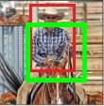
Consider a ground truth object and its corresponding bounding box
Consider the projection of this image onto the conv5 layer
Consider one such cell in the output
This cell corresponds to a patch in the original image
Max-pool
Conv
Input
32/47

Slide 135
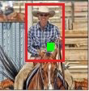
Consider a ground truth object and its corresponding bounding box
Consider the projection of this image onto the conv5 layer
Consider one such cell in the output
This cell corresponds to a patch in the original image
Consider the center of this patch
Max-pool
Conv
Input
32/47

Slide 136
Consider a ground truth object and its corresponding bounding box
Consider the projection of this image onto the conv5 layer
Consider one such cell in the output
This cell corresponds to a patch in the original image
Consider the center of this patch
We consider anchor boxes of different sizes
Max-pool
Conv
Input
32/47

Slide 137

Classification
x1x2 · · · · · ·
For each of these anchor boxes, we would want the classifier to predict
1 if this anchor box has a reason- able overlap (IoU > 0.7) with the true grounding box
Max-pool
Conv
Input
32/47

Slide 138

Classification Regression
x1x2 · · · · · ·
For each of these anchor boxes, we would want the classifier to predict
1 if this anchor box has a reason- able overlap (IoU > 0.7) with the true grounding box
Similarly we would want the regres- sion model to predict the true box (red) from the anchor box (pink)
Max-pool
Conv
Input
32/47

Slide 139
Classification Regression
x1x2 · · · · · ·
We train a classification model and a regression model to address these two questions
How do we get the ground truth data?
What is the objective function used for training?
Max-pool
Conv
Input

Slide 140
The full network is trained using the following objective.
34/47

Slide 141
The full network is trained using the following objective.
1
^{N}cls
L (p , t ) =
L_{cls}(p_{i}, p_{i}∗)
i i
i
34/47

Slide 142
The full network is trained using the following objective.
1
^{N}cls
L (p , t ) =
L_{cls}(p_{i}, p_{i}∗)
i i
i
p∗_{i} = 1 if anchor box contains ground truth object
= 0 otherwise
p_{i} = predicted probability of anchor box containing an object
N_{cls} = batch-size
34/47

Slide 143
The full network is trained using the following objective.
1
^{N}cls
λ
L (p , t ) =
∗
∗
i i
L (p , p ) +
p L
(t , t∗)
cls i i
Nreg
i
reg i
i
i i
p∗_{i} = 1 if anchor box contains ground truth object
= 0 otherwise
p_{i} = predicted probability of anchor box containing an object
N_{cls} = batch-size
34/47

Slide 144
The full network is trained using the following objective.
1
^{N}cls
λ
L (p , t ) =
∗
∗
i i
L (p , p ) +
p L
(t , t∗)
cls i i
Nreg
i
reg i
i
i i
p∗_{i} = 1 if anchor box contains ground truth object
= 0 otherwise
p_{i} = predicted probability of anchor box containing an object
N_{cls} = batch-size
N_{reg} = batch-size × k k = anchor boxes
34/47

Slide 145




Region Proposals
Classification Regression
Fast RCNN
x1
x2
· · · · ·^{x}
512
Max-pool
Conv
Input
35/47

Slide 146
So far we have seen a CNN based ap- proach for region proposals instead of using selective search
Fast RCNN
Region Proposals
Classification Regression
x1
x2
· · · · ·^{x}
512
Max-pool
Conv
Input
35/47

Slide 147
So far we have seen a CNN based ap- proach for region proposals instead of using selective search
Fast RCNN
Region Proposals
Classification Regression
We can now take these region propos- als and then add fast RCNN on top of it to predict the class of the object
x1
x2
· · · · ·^{x}
512
Max-pool
Conv
Input
35/47

Slide 148
So far we have seen a CNN based ap- proach for region proposals instead of using selective search
Fast RCNN
Region Proposals
Classification Regression
We can now take these region propos- als and then add fast RCNN on top of it to predict the class of the object
And regress the proposed bounding box
x1
x2
· · · · ·^{x}
512
Max-pool
Conv
Input
35/47

Slide 149
Region Proposals
Classification Regression
Fast RCNN
x1
x2
· · · · ·^{x}
512
Max-pool
Conv
Input
36/47

Slide 150
But the fast RCNN would again use a VGG Net
Fast RCNN
Region Proposals
Classification Regression
x1
x2
· · · · ·^{x}
512
Max-pool
Conv
Input
36/47

Slide 151
But the fast RCNN would again use a VGG Net
Fast RCNN
Can’t we use a single VGG Net and share the parameters of RPN and RCNN
Region Proposals
Classification Regression
x1
x2
· · · · ·^{x}
512
Max-pool
Conv
Input
36/47

Slide 152
But the fast RCNN would again use a VGG Net
Fast RCNN
Can’t we use a single VGG Net and share the parameters of RPN and RCNN
Yes, we can
Region Proposals
Classification Regression
x1
x2
· · · · ·^{x}
512
Max-pool
Conv
Input
36/47

Slide 153
But the fast RCNN would again use a VGG Net
Fast RCNN
Can’t we use a single VGG Net and share the parameters of RPN and RCNN
Yes, we can
In practice, we use a 4 step alternat- ing training process
Region Proposals
Classification Regression
x1
x2
· · · · ·^{x}
512
Max-pool
Conv
Input
36/47

Slide 154




Faster RCNN:Training
Fast RCNN
Region Proposals Classification Regression
x1
x2
· · · · ·^{x}
512
Max-pool
Conv
Input
37/47

Slide 155


Faster RCNN:Training
Fast RCNN
Fine-tune RPN using a pre-trained ImageNet network
Region Proposals
Classification Regression
x1 | x2 |  |  |  |  |  | 512
· · |  |  |  | · · ·^{x}
Max-pool Conv Input
37/47

Slide 156
Faster RCNN:Training
Fast RCNN
Fine-tune RPN using a pre-trained ImageNet network
Fine-tune fast RCNN from a pre- trained ImageNet network using bounding boxes from step 1
Region Proposals
Classification Regression
x1
x2
· · · · ·^{x}
512
Max-pool
Conv
Input
37/47

Slide 157
Faster RCNN:Training
Fast RCNN
Fine-tune RPN using a pre-trained ImageNet network
Fine-tune fast RCNN from a pre- trained ImageNet network using bounding boxes from step 1
Keeping common convolutional layer parameters fixed from step 2, fine- tune RPN (post conv5 layers)
Region Proposals
Classification Regression
x1
x2
· · · · ·^{x}
512
Max-pool
Conv
Input
37/47

Slide 158
Faster RCNN:Training
Fast RCNN
Fine-tune RPN using a pre-trained ImageNet network
Fine-tune fast RCNN from a pre- trained ImageNet network using bounding boxes from step 1
Keeping common convolutional layer parameters fixed from step 2, fine- tune RPN (post conv5 layers)
Keeping common convolution layer parameters fixed from step 3, fine- tune fc layers of fast RCNN
Region Proposals
Classification Regression
x1
x2
· · · · ·^{x}
512
Max-pool
Conv
Input
37/47

Slide 159
Faster RCNN and RPN are the basis of several 1st place entries in the ILSVRC and COCO tracks on :
38/47

Slide 160
Faster RCNN and RPN are the basis of several 1st place entries in the ILSVRC and COCO tracks on :
Imagenet detection
38/47

Slide 161
Faster RCNN and RPN are the basis of several 1st place entries in the ILSVRC and COCO tracks on :
Imagenet detection COCO Segmentation
38/47

Slide 162
Faster RCNN and RPN are the basis of several 1st place entries in the ILSVRC and COCO tracks on :
Imagenet detection COCO Segmentation Imagenet localization
38/47

Slide 163
Faster RCNN and RPN are the basis of several 1st place entries in the ILSVRC and COCO tracks on :
Imagenet detection COCO Segmentation Imagenet localization COCO detection
38/47

Slide 164
Region proposals
Feature extraction
Classifier
Pre 2012
RCNN
Fast RCNN
Faster RCNN
39/47

Slide 165
Region proposals
Feature extraction
Classifier
Region Proposals: CNN
Pre 2012
RCNN
Fast RCNN
Faster RCNN
39/47

Slide 166
Region proposals
Feature extraction
Classifier
Region Proposals: CNN
Feature Extraction: CNN
Pre 2012
RCNN
Fast RCNN
Faster RCNN
39/47

Slide 167
Region proposals
Feature extraction
Classifier
Region Proposals: CNN Feature Extraction: CNN Classifier: CNN
Pre 2012
RCNN
Fast RCNN
Faster RCNN
39/47

Slide 168

Object Detection Performance
Source: Ross Girshick

Slide 169
Module 12.5 : YOLO model for object detection

Slide 170

The approaches that we have seen so far are two stage approaches
classifier
RoI pooling
proposals
Region Proposal Network
feature maps
conv layers
image
42/47

Slide 171
The approaches that we have seen so far are two stage approaches
classifier
They involve a region proposal stage and then a classification stage
RoI pooling
proposals
Region Proposal Network
feature maps
conv layers
image
42/47

Slide 172
The approaches that we have seen so far are two stage approaches
classifier
They involve a region proposal stage and then a classification stage
RoI pooling
proposals
Region Proposal Network
feature maps
conv layers
image
42/47

Slide 173
The approaches that we have seen so far are two stage approaches
classifier
They involve a region proposal stage and then a classification stage
Can we have an end-to-end architec- ture which does both proposal and classification simultaneously ?
RoI pooling
proposals
Region Proposal Network
feature maps
conv layers
image
42/47

Slide 174
The approaches that we have seen so far are two stage approaches
classifier
They involve a region proposal stage and then a classification stage
Can we have an end-to-end architec- ture which does both proposal and classification simultaneously ?
This is the idea behind YOLO-You Only Look Once.
RoI pooling
proposals
Region Proposal Network
feature maps
conv layers
image
42/47

Slide 175

P (cow)
P (truck)
Divide an image into S × S grids
c | w | h | x | y |  |  | · | ·
(S=7)
P (dog)
S × S grid on input
43/47

Slide 176
P (cow)
P (truck)
Divide an image into S × S grids
c | w | h | x | y |  |  | · | ·
(S=7)
For each such cell we are interested in predicting 5 + k quantities
P (dog)
S × S grid on input
43/47

Slide 177
P (cow)
P (truck)
Divide an image into S × S grids
c | w | h | x | y |  |  | · | ·
(S=7)
For each such cell we are interested in predicting 5 + k quantities
Probability (confidence) that this cell is indeed contained in a true bound- ing box
c
P (dog)
S × S grid on input
43/47

Slide 178
P (cow)
P (truck)
Divide an image into S × S grids
c | w | h | x | y |  |  | · | ·
(S=7)
For each such cell we are interested in predicting 5 + k quantities
Probability (confidence) that this cell is indeed contained in a true bound- ing box
Width of the bounding box
w
P (dog)
S × S grid on input
43/47

Slide 179
P (cow)
P (truck)
Divide an image into S × S grids
c | w | h | x | y |  |  | · | ·
(S=7)
For each such cell we are interested in predicting 5 + k quantities
Probability (confidence) that this cell is indeed contained in a true bound- ing box
Width of the bounding box Height of the bounding box
h
P (dog)
S × S grid on input
43/47

Slide 180
P (cow)
P (truck)
Divide an image into S × S grids
c | w | h | x | y |  |  | · | ·
(S=7)
For each such cell we are interested in predicting 5 + k quantities
Probability (confidence) that this cell is indeed contained in a true bound- ing box
Width of the bounding box Height of the bounding box Center (x,y) of the bounding box
x
y
P (dog)
S × S grid on input
43/47

Slide 181
P (cow)
P (truck)
Divide an image into S × S grids
c | w | h | x | y |  |  | · | ·
(S=7)
For each such cell we are interested in predicting 5 + k quantities
Probability (confidence) that this cell is indeed contained in a true bound- ing box
Width of the bounding box Height of the bounding box Center (x,y) of the bounding box
Probability of the object in the bounding box belonging to the k^{th} class (k - values)
· ·
P (dog)
S × S grid on input
43/47

Slide 182
P (cow)
P (truck)
Divide an image into S × S grids
c | w | h | x | y |  |  | · | ·
(S=7)
For each such cell we are interested in predicting 5 + k quantities
Probability (confidence) that this cell is indeed contained in a true bound- ing box
Width of the bounding box Height of the bounding box Center (x,y) of the bounding box
Probability of the object in the bounding box belonging to the k^{th} class (k - values)
The output layer thus contains S ×
· ·
P (dog)
S × S grid on input
S × (5 + k) elements
43/47

Slide 183

How do we interpret this S×S×(5+k) dimensional output?
Input Image
44/47

Slide 184
How do we interpret this S×S×(5+k)
dimensional output?
For each cell, we are computing a bounding box, its confidence and the object in it
S × S grid on input
44/47

Slide 185
How do we interpret this S×S×(5+k)
dimensional output?
For each cell, we are computing a bounding box, its confidence and the object in it
S × S grid on input
44/47

Slide 186
How do we interpret this S×S×(5+k)
dimensional output?
For each cell, we are computing a bounding box, its confidence and the object in it
S × S grid on input
44/47

Slide 187
How do we interpret this S×S×(5+k)
dimensional output?
For each cell, we are computing a bounding box, its confidence and the object in it
S × S grid on input
44/47

Slide 188
How do we interpret this S×S×(5+k)
dimensional output?
For each cell, we are computing a bounding box, its confidence and the object in it
S × S grid on input
44/47

Slide 189
How do we interpret this S×S×(5+k)
dimensional output?
For each cell, we are computing a bounding box, its confidence and the object in it
S × S grid on input
44/47

Slide 190
How do we interpret this S×S×(5+k)
dimensional output?
For each cell, we are computing a bounding box, its confidence and the object in it
S × S grid on input
44/47

Slide 191
How do we interpret this S×S×(5+k)
dimensional output?
For each cell, we are computing a bounding box, its confidence and the object in it
S × S grid on input
44/47

Slide 192
How do we interpret this S×S×(5+k)
dimensional output?
For each cell, we are computing a bounding box, its confidence and the object in it
S × S grid on input
Bounding Boxes & Confidence
44/47

Slide 193

How do we interpret this S×S×(5+k) dimensional output?
For each cell, we are computing a bounding box, its confidence and the object in it
We then retain the most confident bounding boxes and the correspond- ing object label
44/47

Slide 194
How do we train this network ?
cˆ | wˆ | _{h}ˆ | xˆ | yˆ | ˆ₁ | ˆ₂ | · | · | ˆ k
S × S grid on input
45/47

Slide 195

How do we train this network ?
Consider a cell such that the center of the true bonding box lies in it
cˆ | wˆ | _{h}ˆ | xˆ | yˆ | ˆ₁ | ˆ₂ | · | · | ˆ k
S × S grid on input
45/47

Slide 196
How do we train this network ?
Consider a cell such that the center of the true bonding box lies in it
The network is initialized randomly and it will predict some values for c, w, h, x, y & £
cˆ | wˆ | _{h}ˆ | xˆ | yˆ | ˆ₁ | ˆ₂ | · | · | ˆ k
S × S grid on input
45/47

Slide 197
How do we train this network ?
Consider a cell such that the center of the true bonding box lies in it
The network is initialized randomly and it will predict some values for c, w, h, x, y & £
We can then compute the following losses
cˆ | wˆ | _{h}ˆ | xˆ | yˆ | ˆ₁ | ˆ₂ | · | · | ˆ k
S × S grid on input
45/47

Slide 198
How do we train this network ?
Consider a cell such that the center of the true bonding box lies in it
The network is initialized randomly and it will predict some values for c, w, h, x, y & £
We can then compute the following losses
(1 − cˆ)²
c | wˆ | _{h}ˆ | xˆ | yˆ | ˆ₁ | ˆ₂ | · | · | ˆ k
cˆ
S × S grid on input
45/47

Slide 199
How do we train this network ?
Consider a cell such that the center of the true bonding box lies in it
The network is initialized randomly and it will predict some values for c, w, h, x, y & £
We can then compute the following losses
(√w − √wˆ)²
cˆ | w | _{h}ˆ | xˆ | yˆ | ˆ₁ | ˆ₂ | · | · | ˆ k
wˆ
S × S grid on input
45/47

Slide 200
How do we train this network ?
Consider a cell such that the center of the true bonding box lies in it
The network is initialized randomly and it will predict some values for c, w, h, x, y & £
We can then compute the following losses
(√h − h^{ˆ})²
cˆ | wˆ | h | xˆ | yˆ | ˆ₁ | ˆ₂ | · | · | ˆ k
_{h}ˆ
S × S grid on input
45/47

Slide 201
How do we train this network ?
Consider a cell such that the center of the true bonding box lies in it
The network is initialized randomly and it will predict some values for c, w, h, x, y & £
We can then compute the following losses
(x − xˆ)²
cˆ | wˆ | _{h}ˆ | x | y | ˆ₁ | ˆ₂ | · | · | ˆ k
xˆ
yˆ
S × S grid on input
45/47

Slide 202
How do we train this network ?
Consider a cell such that the center of the true bonding box lies in it
The network is initialized randomly and it will predict some values for c, w, h, x, y & £
We can then compute the following losses
(y − yˆ)²
cˆ | wˆ | _{h}ˆ | x | y | ˆ₁ | ˆ₂ | · | · | ˆ k
xˆ
yˆ
S × S grid on input
45/47

Slide 203
How do we train this network ?
P (cow)
P (truck)
Consider a cell such that the center of the true bonding box lies in it
The network is initialized randomly and it will predict some values for c, w, h, x, y & £
We can then compute the following losses
cˆ | wˆ | _{h}ˆ | xˆ | yˆ |  |  | · | ·
^{ˆ}1 ^{ˆ}2 · · ^{ˆ}
k
P (dog)
k i=1
(£_{i} − £^{ˆ}_{i})²
S × S grid on input
45/47

Slide 204
How do we train this network ?
P (cow)
P (truck)
Consider a cell such that the center of the true bonding box lies in it
The network is initialized randomly and it will predict some values for c, w, h, x, y & £
We can then compute the following losses
cˆ | wˆ | _{h}ˆ | xˆ | yˆ |  |  | · | ·
^{ˆ}1 ^{ˆ}2 · · ^{ˆ}
k
P (dog)
k i=1
(£_{i} − £^{ˆ}_{i})²
And train the network to minimize the sum of these losses
S × S grid on input
45/47

Slide 205
Now consider a grid which does not contain any object
cˆ | wˆ | _{h}ˆ | xˆ | yˆ | ˆ₁ | ˆ₂ | · | · | ˆ k
S × S grid on input
46/47

Slide 206
Now consider a grid which does not contain any object
cˆ
wˆ h^{ˆ} xˆ ^{yˆ} ^{ˆ}1 ^{ˆ}2 · · ^{ˆ}
k
For this grid we do not care about the predictions w, h, x, y & £
S × S grid on input
46/47

Slide 207
Now consider a grid which does not contain any object
cˆ
wˆ h^{ˆ} xˆ ^{yˆ} ^{ˆ}1 ^{ˆ}2 · · ^{ˆ}
k
For this grid we do not care about the predictions w, h, x, y & £
But we want the confidence to be low
S × S grid on input
46/47

Slide 208
Now consider a grid which does not contain any object
cˆ
wˆ h^{ˆ} xˆ ^{yˆ} ^{ˆ}1 ^{ˆ}2 · · ^{ˆ}
k
For this grid we do not care about the predictions w, h, x, y & £
But we want the confidence to be low So we minimize only the following loss
(0 − cˆ)²
S × S grid on input
46/47

Slide 209
Method | Pascal 2007 mAP | Speed
DPM v5 | 33.7 | 0.07 FPS — 14 sec/ image
47/47

Slide 210
Method | Pascal 2007 mAP | Speed
DPM v5 | 33.7 | 0.07 FPS — 14 sec/ image
RCNN | 66.0 | 0.05 FPS — 20 sec/ image
47/47

Slide 211
Method | Pascal 2007 mAP | Speed
DPM v5 | 33.7 | 0.07 FPS — 14 sec/ image
RCNN | 66.0 | 0.05 FPS — 20 sec/ image
Fast RCNN | 70.0 | 0.5 FPS — 2 sec/ image
47/47

Slide 212
Method | Pascal 2007 mAP | Speed
DPM v5 | 33.7 | 0.07 FPS — 14 sec/ image
RCNN | 66.0 | 0.05 FPS — 20 sec/ image
Fast RCNN | 70.0 | 0.5 FPS — 2 sec/ image
Faster RCNN | 73.2 | 7 FPS — 140 msec/ image
47/47

Slide 213
Method | Pascal 2007 mAP | Speed
DPM v5 | 33.7 | 0.07 FPS — 14 sec/ image
RCNN | 66.0 | 0.05 FPS — 20 sec/ image
Fast RCNN | 70.0 | 0.5 FPS — 2 sec/ image
Faster RCNN | 73.2 | 7 FPS — 140 msec/ image
YOLO | 69.0 | 45 FPS — 22 msec/ image
47/47

